Slide 1
The Three Rs
RELATIONSHIP
RESPECT
RESTRAINT

Slide 2
THINK ABOUT A TIME
Think about a time when someone gave you advice without RELATIONSHIP, RESPECT or RESTRAINT.
~ What was missing of the three Rs?
~ What the impact on you? On your brain?
~ How well did the advice land with you?

Slide 3
RELATIONSHIP
Being connected to the other person; investing time and interest beyond the topic or issue to understand the broader context of their lives; person understands you have their best interests at heart

Slide 4
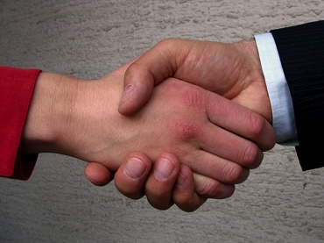
RESPECT
Two-way street: respect for other person’s inherent creativity and resourcefulness; establish credibility that a) you have useful advice to give and b) advice is not being offered to bolster your own ego

Slide 5
RESTRAINT
Make sure the other person’s brain is in a receptive mode, which occurs when you listen, are curious, demonstrate warmth and openness, and more.

